Slide 1
My name is Matthew David Watson

Slide 3
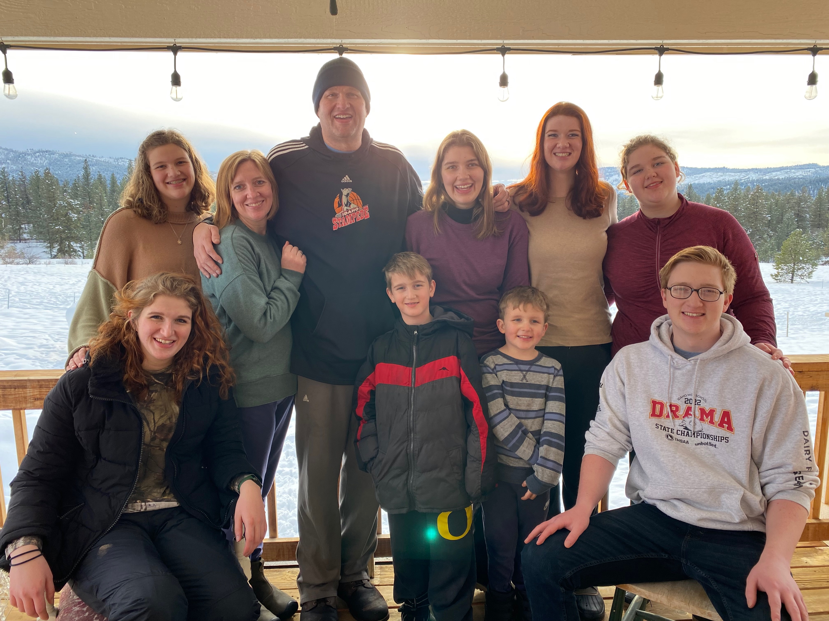
Family
You can call me Matt.
I have five older sisters, an older brother and a younger brother.
You can me Matt.
There are ten of us in my family
I have five older sisters
One Older Brother
One Younger Brother

Slide 4
A few of my Favorite things
Sushi
Cockatiels
Board Games
Reading
Percy Jackson- Battle of the Labyrinth
Science Experiments
Greek Mythology
Swimming & Camping
Building Fires
Lemon Lime Gatorade

Slide 5
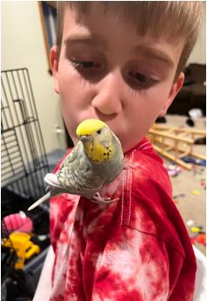
Pets
Captain A. Dog or Captain
Sylphrena or Syl

Slide 6
Ponderosa State Park
Review
My favorite place to camp is Ponderosa State Park.
It has lots of trees
Plenty of room for my whole family
Has good things to find
There is a lake for swimming
Places to explore

